Slide 1
Creating 3d models from images
Andrew Zhang

Slide 2
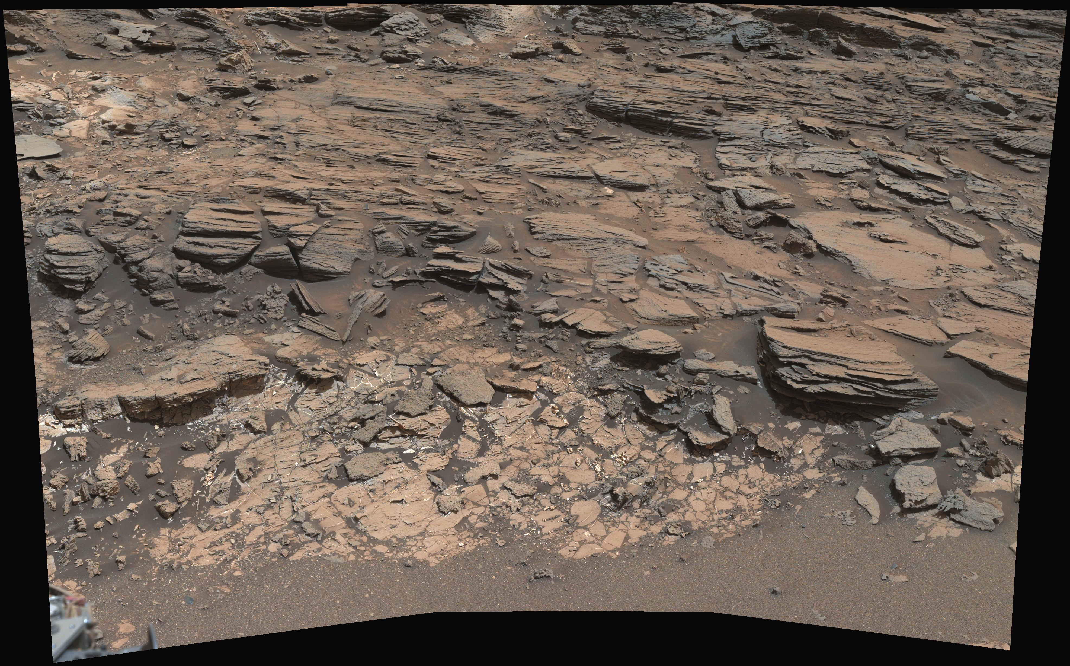
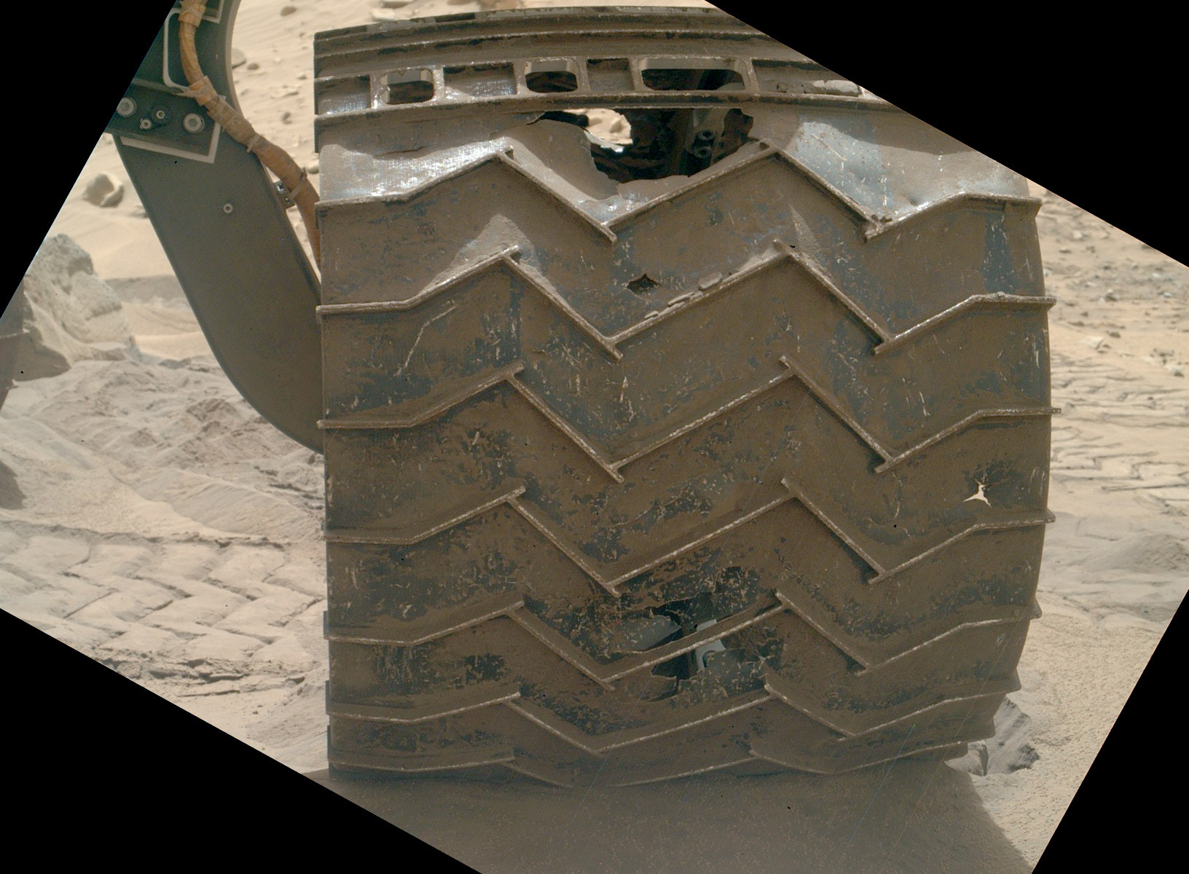
Problem
Because of this lack of info, there can be significant damage
https://planetary.s3.amazonaws.com/assets/images/spacecraft/2014/20140818_0713MH0002620000204354E01_DXXX.jpg
https://photojournal.jpl.nasa.gov/jpeg/PIA19676.jpg

Slide 3
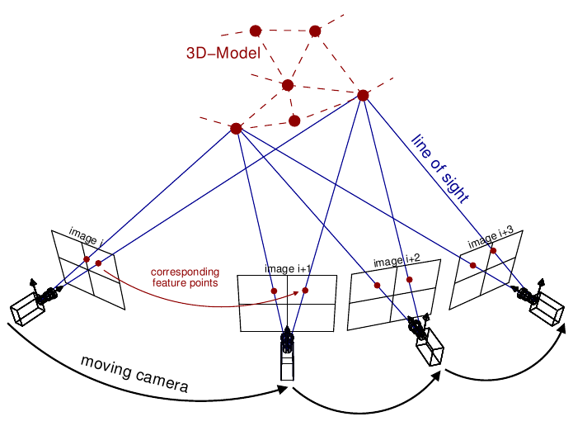
Problem
Photogrammetry is a set of techniques to get measurements from images.
It can be used to create models
Has limitations
Must have pictures all around
Curiosity only moved 1km in 1 year
Means its hard to do this
Neural Networks can solve this
http://theia-sfm.org/_images/incremental_sfm.png

Slide 4
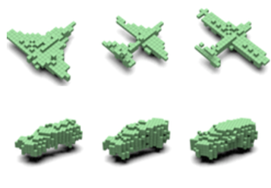

Current research
Recent research done used silhouettes to help in the creation of models.
This can work pretty well
But even it has limitations

Slide 5
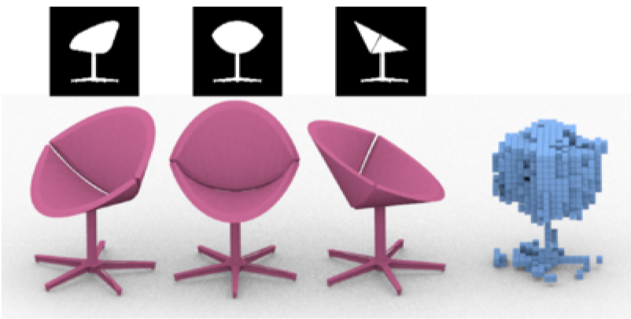
Current stuff
The network failed.

Slide 6
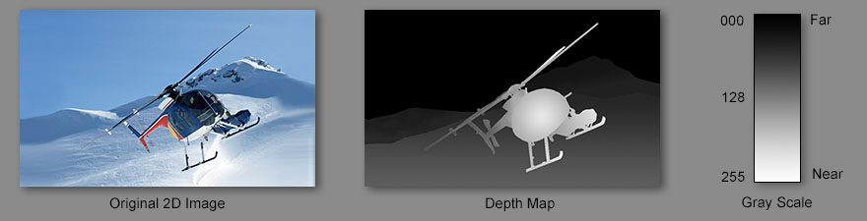
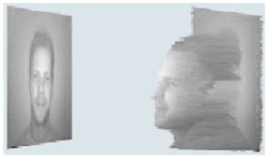
Solving the problems
http://www.i-art3d.com/Eng/Images/Depth_Map.jpg
https://lh3.googleusercontent.com/a_Ui1-r3ibD8cNldDz54MCEJ8mkDywRsLH2qHYn-8BOf9I5m7sN-H3lRqPb8pGc4Pe4-7Q=s145

Slide 7
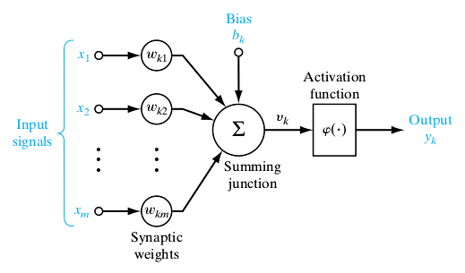

Background
So how does this network work?
Neural networks are a way of modeling datasets.
They have several advantages compared to other methods.
Many dimensions
Very generalizable
Significantly easier to create
https://towardsdatascience.com/everything-you-need-to-know-about-neural-networks-and-backpropagation-machine-learning-made-easy-e5285bc2be3a
https://medium.com/@viniciusarruda/a-brief-introduction-to-artificial-neural-networks-7c74e5344bf8

Slide 8

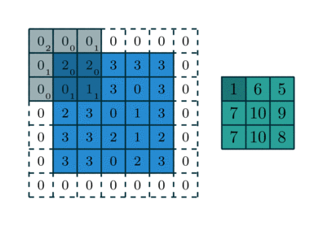
Convolutional Neural Network
http://deeplearning.net/software/theano/tutorial/conv_arithmetic.html

Slide 9
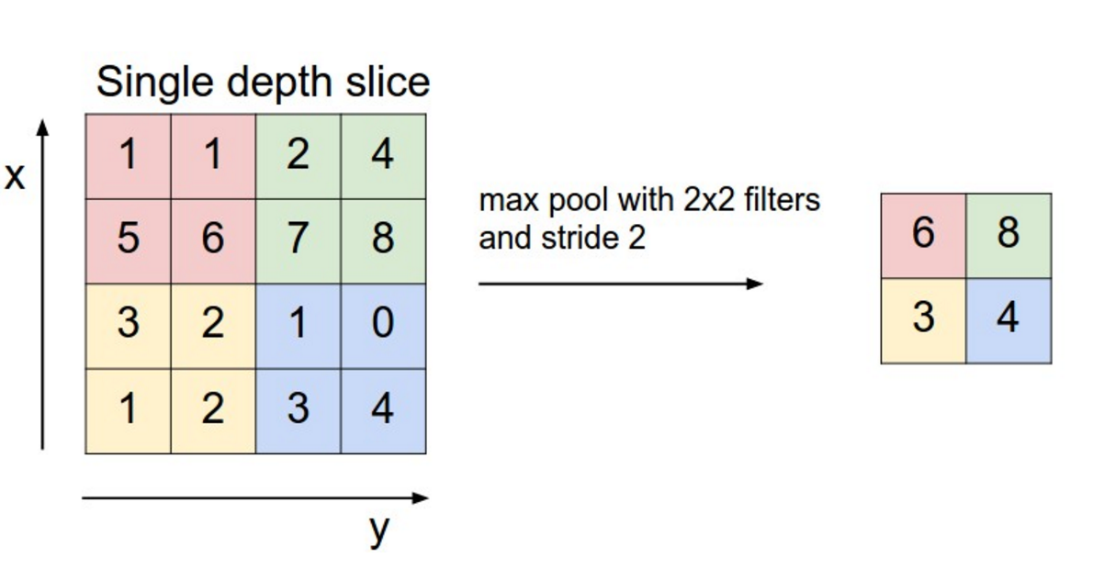
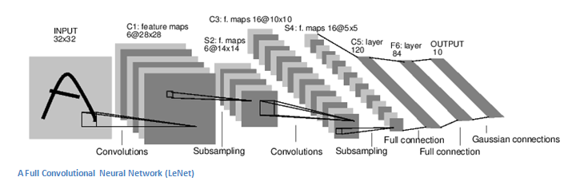
https://cdn-images-1.medium.com/max/1600/1*SmiydxM5lbTjoKWYPiuzWQ.png
https://cdn-images-1.medium.com/max/2000/1*1TI1aGBZ4dybR6__DI9dzA.png

Slide 10
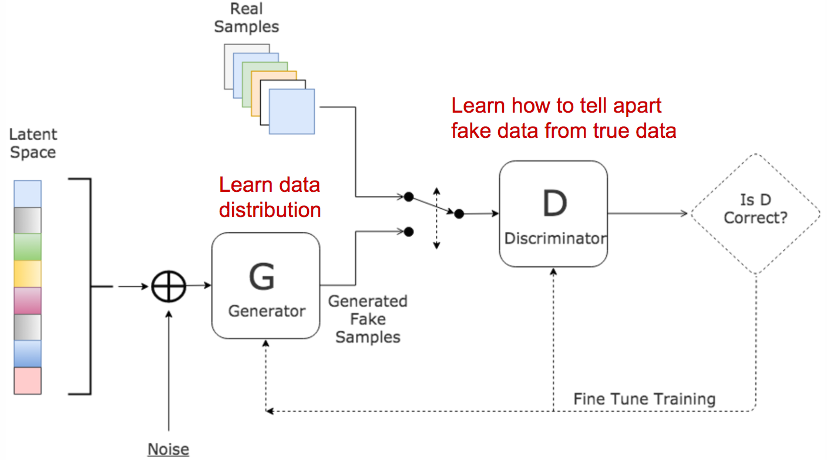
Generative Adversarial Networks
https://d255esdrn735hr.cloudfront.net/graphics/9781789130331/graphics/3beb806c-7da3-4919-8712-42a109144fb7.png

Slide 11
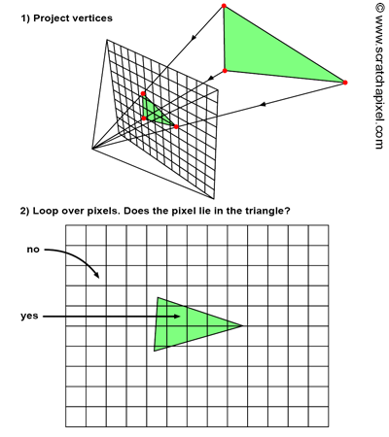
Differentiable Rendering
Is a way to create images without disrupting the training process
Helps bridge the gap between 2D and 3D
https://www.scratchapixel.com/lessons/3d-basic-rendering/rasterization-practical-implementation

Slide 12

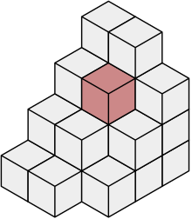
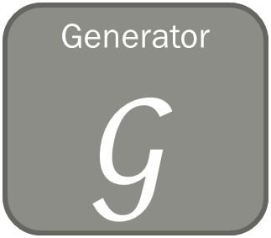

https://upload.wikimedia.org/wikipedia/commons/thumb/b/bc/Voxels.svg/220px-Voxels.svg.png
Differentiable renderer
Generator$𝒢$
Discriminator
$$𝒟$$
Real or Generated?
Latent space
Output model
Training/Input Picture

Slide 13
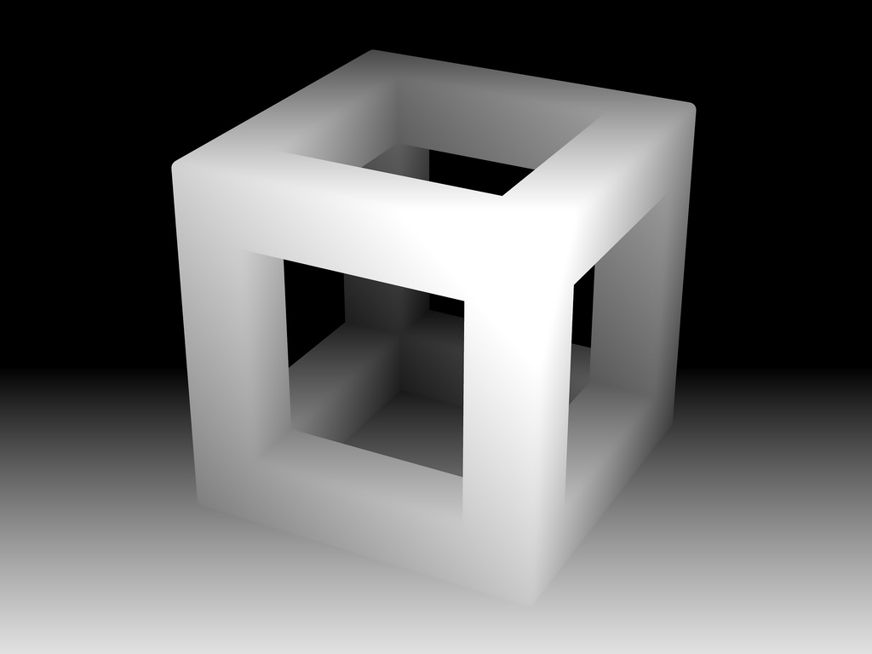
https://upload.wikimedia.org/wikipedia/commons/thumb/b/bc/Voxels.svg/220px-Voxels.svg.png
http://ericpolman.com/2016/03/17/reflective-shadow-maps/
Differentiable renderer
Generator$𝒢$
Discriminator
$$𝒟$$
Real or Generated?
Latent space
Output model
Training/Input Picture

Slide 14
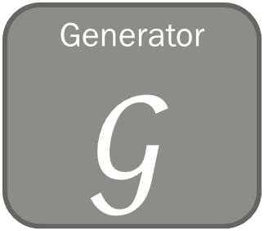

Results/Progress
Generator$𝒢$
Discriminator
$$𝒟$$
https://upload.wikimedia.org/wikipedia/commons/thumb/b/bc/Voxels.svg/220px-Voxels.svg.png
Latent space
Output model
Training/Input Picture

Slide 15
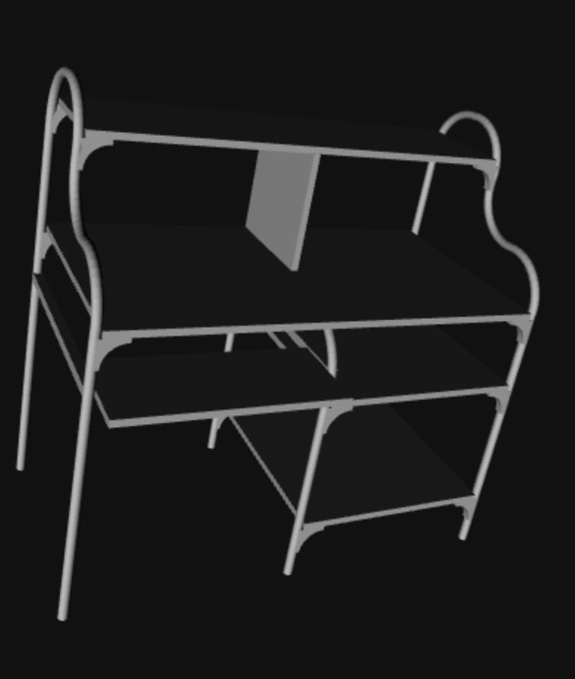
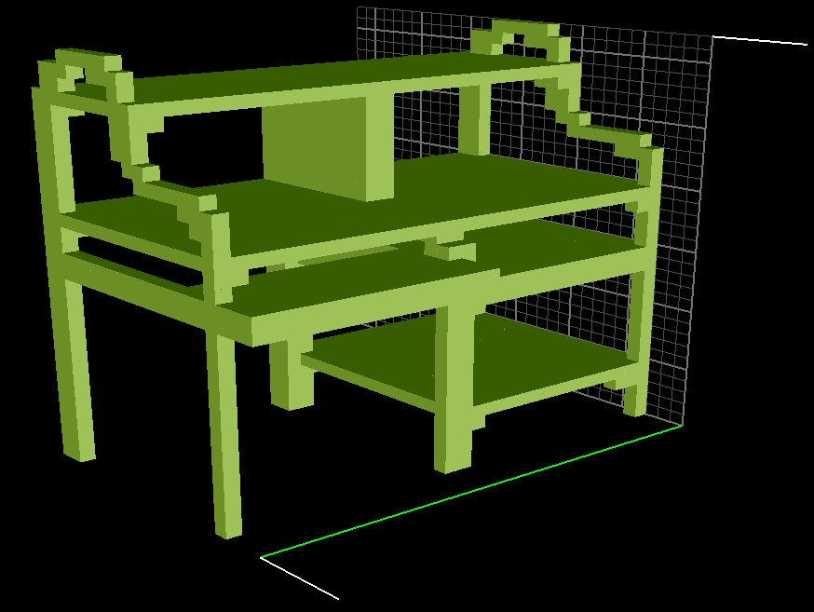
Results/Progress
Data processing is done
Network is still outputting noise and not working well.

Slide 16
Workflow
Big Idea: Use GANs to generate models of objects from images
Datasets
Preprocessing
Networks
Compare output to actual model
SUN3D, ICL-NUIM RGB-D, Shapenet
Create 2D images as test input into the network
Create GAN
Evaluate using Mean Distance Error
Create depth map of object as input
Create 3D Models

Slide 17
Conclusion
Previous research has attempted to create models from images
Has limitations
Adding depth would help

Slide 18
References
Gadelha, M., Maji, S., & Wang, R. (2016). 3D Shape Induction from 2D Views of Multiple Objects. arXiv:1612.05872 [cs.CV]
Goodfellow, I., Pouget-Abadie, J., Mirza, M., Xu, B., Warde-Farley, D., Ozair, S., . . . Bengio, Y. (2014). Generative Adversarial Nets. Advances in Neural Information Processing Systems, 27, pp. 2672–2680. arXiv:1406.2661 [stat.ML]
Wu, J., Zhang, C., Xue, T., Freeman, W., & Tenenbaum, J. (2016). Learning a Probabilistic Latent Space of Object Shapes via 3D Generative-Adversarial Modeling. arXiv:1610.07584 [cs.CV]

Slide 19
Image references
Picture of Curiosity’s wheel is from NASA/JPL/MSSS/Emily Lakdawalla
Picture of Martian surface is from NASA/JPL-Caltech/MSSS
Photogrammetry diagram is from http://theia-sfm.org/_images/incremental_sfm.png
Silhouettes and models are from Gadelha et al. (2016)
Helicopter depth map is from http://www.i-art3d.com/Eng/Images/Depth_Map.jpg
Face depth map is from https://lh3.googleusercontent.com/a_Ui1-r3ibD8cNldDz54MCEJ8mkDywRsLH2qHYn-8BOf9I5m7sN-H3lRqPb8pGc4Pe4-7Q=s145
Neural net diagram is from https://towardsdatascience.com/everything-you-need-to-know-about-neural-networks-and-backpropagation-machine-learning-made-easy-e5285bc2be3a
Neuron diagram is from https://medium.com/@viniciusarruda/a-brief-introduction-to-artificial-neural-networks-7c74e5344bf8
Convolution diagrams is from http://deeplearning.net/software/theano/tutorial/conv_arithmetic.html
Pooling diagram is from https://cdn-images-1.medium.com/max/1600/1*SmiydxM5lbTjoKWYPiuzWQ.png
LeNet5 diagram is from https://cdn-images-1.medium.com/max/2000/1*1TI1aGBZ4dybR6__DI9dzA.png
Rasterization diagram is from https://www.scratchapixel.com/lessons/3d-basic-rendering/rasterization-practical-implementation
Voxel diagram is from https://upload.wikimedia.org/wikipedia/commons/thumb/b/bc/Voxels.svg/220px-Voxels.svg.png
Image of depth is from http://ericpolman.com/2016/03/17/reflective-shadow-maps/
Images of the silhouette was created by me.
Picture of the desk was created by me.

Slide 20


Expanding dimensions (reserve)
http://deeplearning.net/software/theano/tutorial/conv_arithmetic.html

